Slide 1

Snakes and Ladders using BFS
Rohit Raval
Aniruddh Kulkarni
Khushal Sharma

Slide 2

BFS
In BFS, our input is graph G and start vertex is S
Pseudocode of BFS is as follows
mark s as visited
add S to the queue
while queue not empty:
currentVertex = queue.Dequeue
for each adjacentVertex of currentVertex:
if adjacentVertex is unvisited:
add adjacentVertex to queue
mark adjacentVertex as visited

Slide 3
Interpretation
Add
Add start vertex S to the queue
Remove
Remove an element from queue
Add
Add all its unvisited adjacent vertices to queue
Repeat
Repeat from step 2 until queue is empty

Slide 4
Diving Deep in the pseudocode
1
mark s as visited
add S to the queue
while queue not empty:
currentVertex = queue.Dequeue
for each adjacentVertex of currentVertex:
if adjacentVertex is unvisited:
add adjacentVertex to queue
mark adjacentVertex as visited
queue = {1} Initial State
Say start vertex as S = 1
Mark vertex 1 as visited
Add vertex 1 to the queue
2
3
4

Slide 5
Diving Deep in the pseudocode
1
mark s as visited
add S to the queue
while queue not empty:
currentVertex = queue.Dequeue
for each adjacentVertex of currentVertex:
if adjacentVertex is unvisited:
add adjacentVertex to queue
mark adjacentVertex as visited
queue = { } Outer loop iteration 1
currentVertex = 1
2
3
4

Slide 6
Diving Deep in the pseudocode
1
mark s as visited
add S to the queue
while queue not empty:
currentVertex = queue.Dequeue
for each adjacentVertex of currentVertex:
if adjacentVertex is unvisited:
add adjacentVertex to queue
mark adjacentVertex as visited
queue = { } Outer loop iteration 1
currentVertex = 1 Only Vertex 2 is adjacent to vertex 1
adjacentVertex = 2
2
3
4

Slide 7
Diving Deep in the pseudocode
1
mark s as visited
add S to the queue
while queue not empty:
currentVertex = queue.Dequeue
for each adjacentVertex of currentVertex:
if adjacentVertex is unvisited:
add adjacentVertex to queue
mark adjacentVertex as visited
queue = {2} Outer loop iteration 1
currentVertex = 1 Inner loop iteration 1
adjacentVertex = 2 Vertex 2 is unvisted
Mark Vertex 2 as visited and add it to the queue
2
3
4

Slide 8
Diving Deep in the pseudocode
1
mark s as visited
add S to the queue
while queue not empty:
currentVertex = queue.Dequeue
for each adjacentVertex of currentVertex:
if adjacentVertex is unvisited:
add adjacentVertex to queue
mark adjacentVertex as visited
queue = { } Outer loop iteration 2
currentVertex = 2
2
3
4

Slide 9
Diving Deep in the pseudocode
1
mark s as visited
add S to the queue
while queue not empty:
currentVertex = queue.Dequeue
for each adjacentVertex of currentVertex:
if adjacentVertex is unvisited:
add adjacentVertex to queue
mark adjacentVertex as visited
queue = { } Outer loop iteration 2
currentVertex = 2 Verices 1, 3, 4 are adjacent to Vertex 2
Let's go by that order
2
3
4

Slide 10
Diving Deep in the pseudocode
1
mark s as visited
add S to the queue
while queue not empty:
currentVertex = queue.Dequeue
for each adjacentVertex of currentVertex:
if adjacentVertex is unvisited:
add adjacentVertex to queue
mark adjacentVertex as visited
queue = { } Outer loop iteration
currentVertex = 2 Inner loop iteration
adjacentVertex = 1 Vertex 1 is already marked as visited. So, we don’t do anything
2
3
4

Slide 11
Diving Deep in the pseudocode
1
mark s as visited
add S to the queue
while queue not empty:
currentVertex = queue.Dequeue
for each adjacentVertex of currentVertex:
if adjacentVertex is unvisited:
add adjacentVertex to queue
mark adjacentVertex as visited
queue = { 3 } Outer loop iteration 2
currentVertex = 2 Inner loop iteration 2
adjacentVertex = 3 Vertex 3 not visted
Add it to the queue and mark it as visited
2
3
4

Slide 12
Diving Deep in the pseudocode
1
mark s as visited
add S to the queue
while queue not empty:
currentVertex = queue.Dequeue
for each adjacentVertex of currentVertex:
if adjacentVertex is unvisited:
add adjacentVertex to queue
mark adjacentVertex as visited
queue = { 3, 4 } Outer for loop iteration 2
currentVertex = 2 Inner loop iteration 3
adjacentVertex = 4 Vertex 4 Is not visited
Add it to queue and mark it as visited
2
3
4

Slide 13
Diving Deep in the pseudocode
1
mark s as visited
add S to the queue
while queue not empty:
currentVertex = queue.Dequeue
for each adjacentVertex of currentVertex:
if adjacentVertex is unvisited:
add adjacentVertex to queue
mark adjacentVertex as visited
queue = { 4 } Outer loop iteration 3
currentVertex = 3
2
3
4

Slide 14
Diving Deep in the pseudocode
1
mark s as visited
add S to the queue
while queue not empty:
currentVertex = queue.Dequeue
for each adjacentVertex of currentVertex:
if adjacentVertex is unvisited:
add adjacentVertex to queue
mark adjacentVertex as visited
queue = { 4 } Outer loop iteration 3
currentVertex = 3 Inner loop iteration 1
adjacentVertex = 2 Vertex 2 is adjacent to Vertex 3
2
3
4

Slide 15
Diving Deep in the pseudocode
1
mark s as visited
add S to the queue
while queue not empty:
currentVertex = queue.Dequeue
for each adjacentVertex of currentVertex:
if adjacentVertex is unvisited:
add adjacentVertex to queue
mark adjacentVertex as visited
queue = { 4 } Outer loop iteration 3
currentVertex = 3 Inner loop iteration 1
adjacentVertex = 2 Vertex 2 is already marked as visited. So, we don’t do anything
2
3
4

Slide 16
Diving Deep in the pseudocode
1
mark s as visited
add S to the queue
while queue not empty:
currentVertex = queue.Dequeue
for each adjacentVertex of currentVertex:
if adjacentVertex is unvisited:
add adjacentVertex to queue
mark adjacentVertex as visited
queue = { 4 } Outer loop iteration 4
currentVertex = 3 Inner loop iteration 2
adjacentVertex = 4 Vertex 4 is already marked as visited. So, we don’t do anything
2
3
4

Slide 17
Diving Deep in the pseudocode
1
mark s as visited
add S to the queue
while queue not empty:
currentVertex = queue.Dequeue
for each adjacentVertex of currentVertex:
if adjacentVertex is unvisited:
add adjacentVertex to queue
mark adjacentVertex as visited
queue = { } Outer loop iteration 4
currentVertex = 4
2
3
4

Slide 18
Diving Deep in the pseudocode
1
mark s as visited
add S to the queue
while queue not empty:
currentVertex = queue.Dequeue
for each adjacentVertex of currentVertex:
if adjacentVertex is unvisited:
add adjacentVertex to queue
mark adjacentVertex as visited
queue = { } Outer loop iteration 4
currentVertex = 4 Vertex 2 and 3 are adjacent to Vertex 4
2
3
4

Slide 19
Diving Deep in the pseudocode
1
mark s as visited
add S to the queue
while queue not empty:
currentVertex = queue.Dequeue
for each adjacentVertex of currentVertex:
if adjacentVertex is unvisited:
add adjacentVertex to queue
mark adjacentVertex as visited
queue = { } Outer loop iteration 4
currentVertex = 4 Inner loop iteration 1
Vertex 2, is already marked as visited. So we don’t do anything
2
3
4

Slide 20
Diving Deep in the pseudocode
1
mark s as visited
add S to the queue
while queue not empty:
currentVertex = queue.Dequeue
for each adjacentVertex of currentVertex:
if adjacentVertex is unvisited:
add adjacentVertex to queue
mark adjacentVertex as visited
queue = { } Outer loop iteration 4
currentVertex = 4 Inner loop iteration 1
adjacentVertex = 3 Vertex 3, is already marked as visited. So we don’t do anything
2
3
4

Slide 21
Diving Deep in the pseudocode
1
mark s as visited
add S to the queue
while queue not empty:
currentVertex = queue.Dequeue
for each adjacentVertex of currentVertex:
if adjacentVertex is unvisited:
add adjacentVertex to queue
mark adjacentVertex as visited
queue = { } Our queue is empty
So, we don’t have an iteration 5
We’re done
2
3
4

Slide 22
Performance
Time complexity of Breadth First Search is O(V+E)

Slide 23
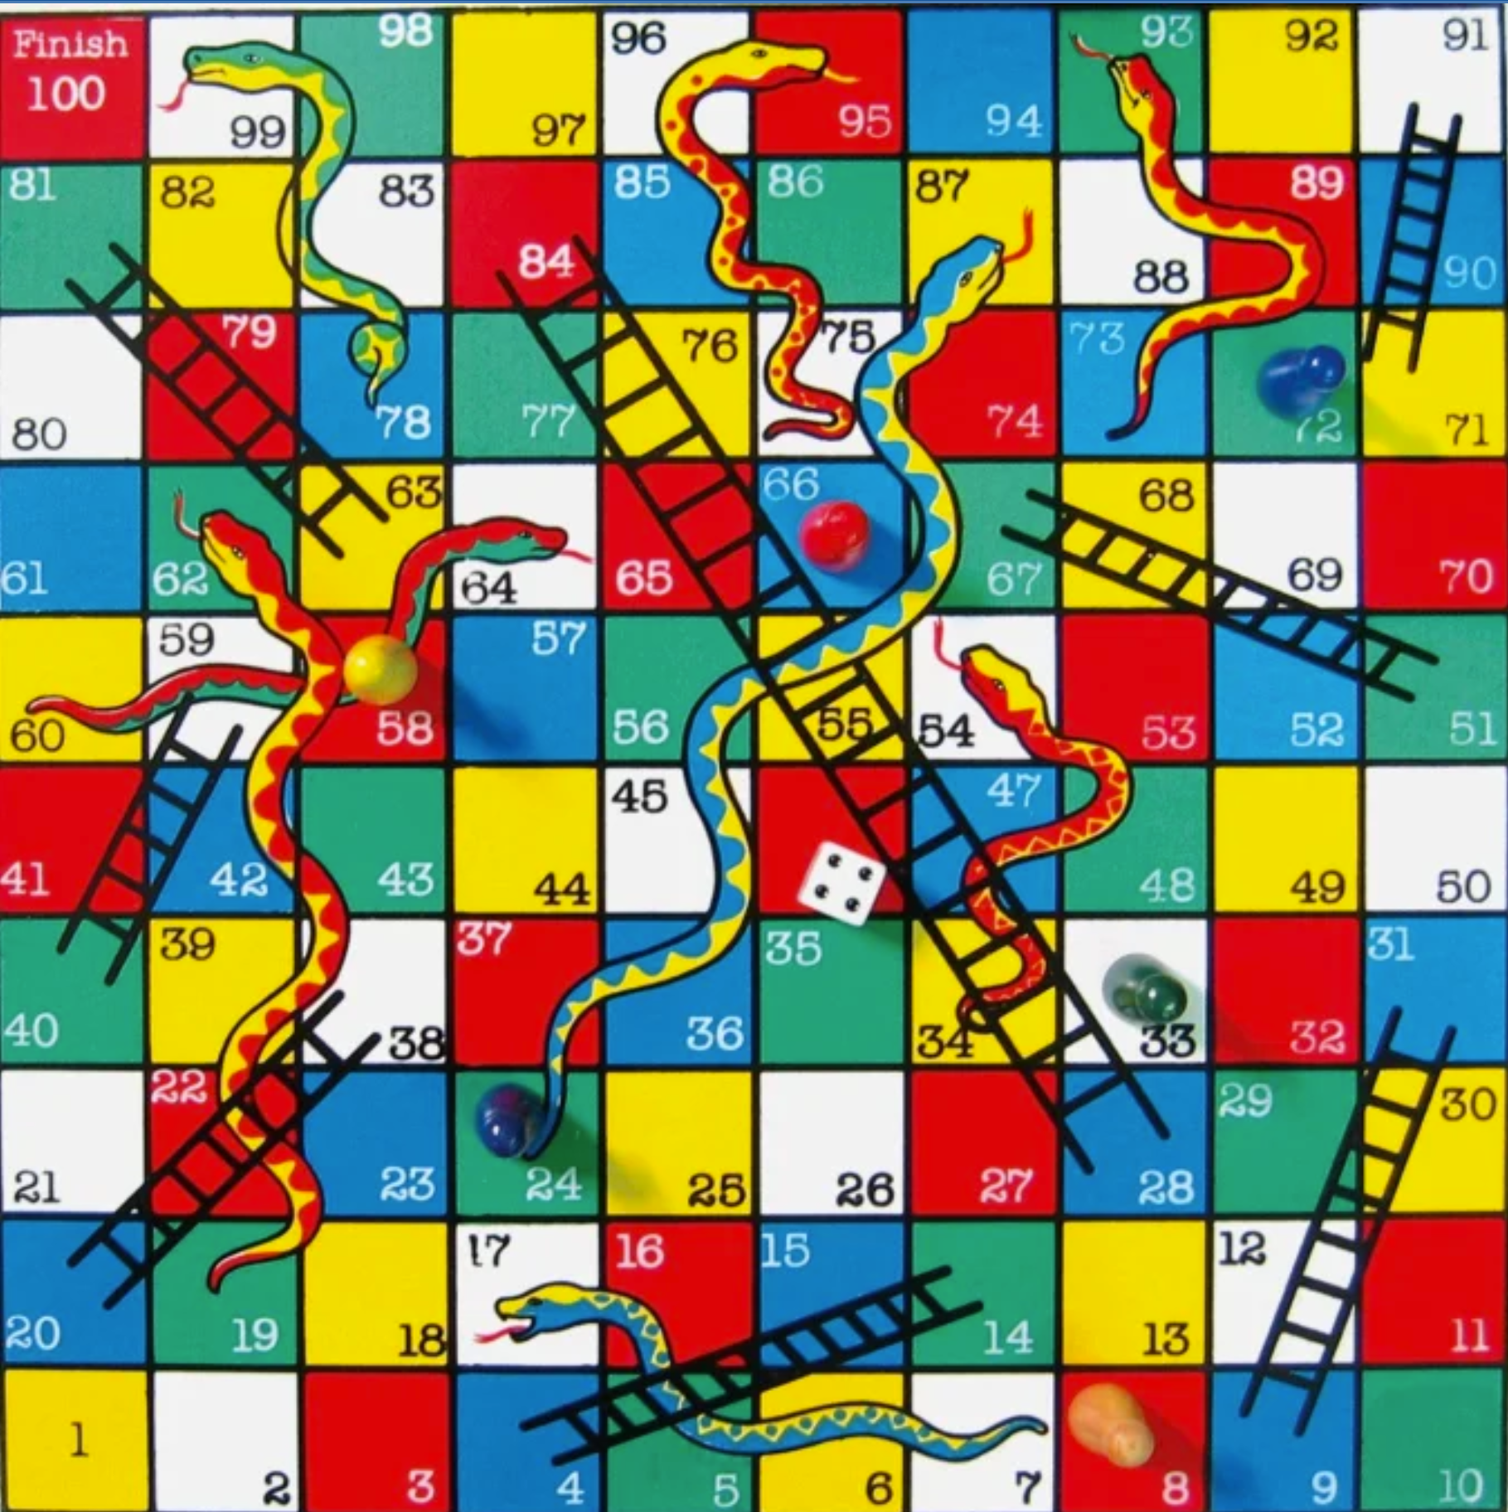
The Problem
For a given configuration of a Snakes and Ladders board, find the shortest path to finish the game
Steps to solve this
Represent the board as a graph
Run BFS on the graph

Slide 24
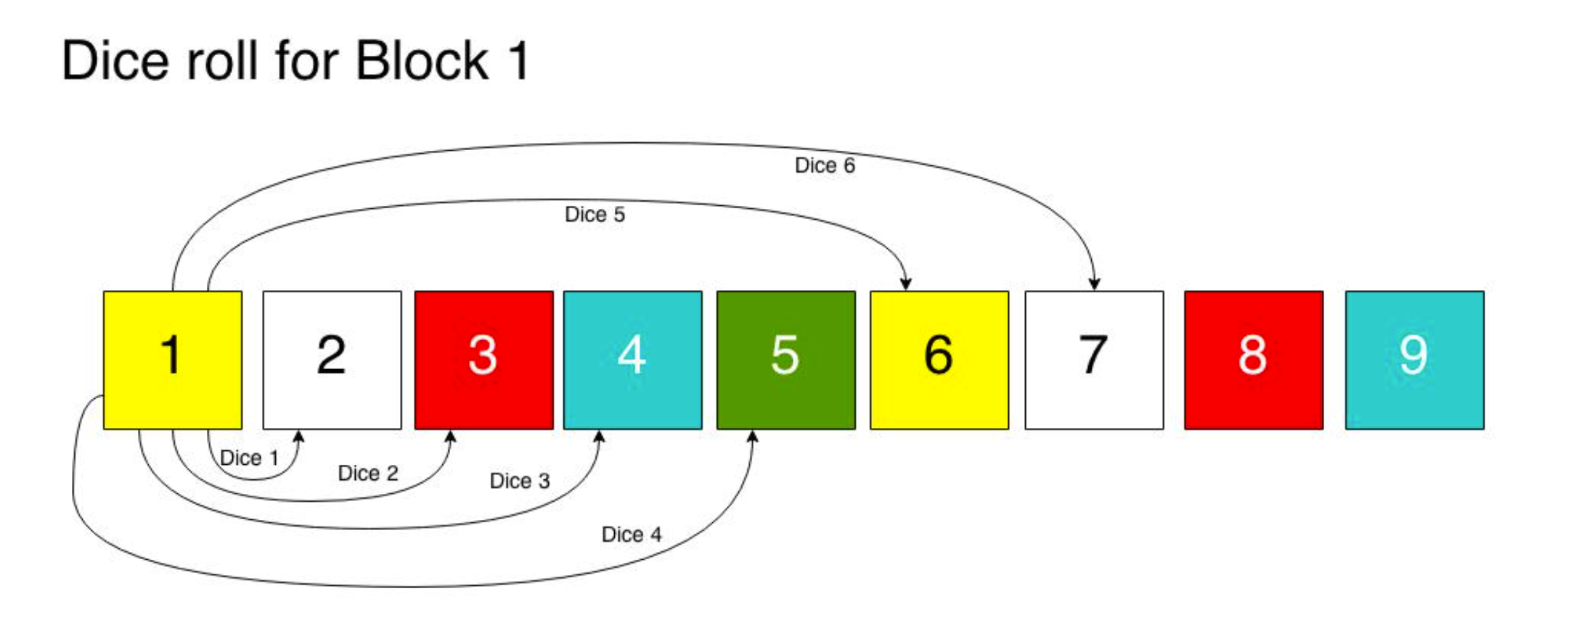
Graph Representation
Each block from 1 to 100 is a vertex
Each possible move from a dice roll, is an edge
Start vertex is 1. End vertex is 100

Slide 25
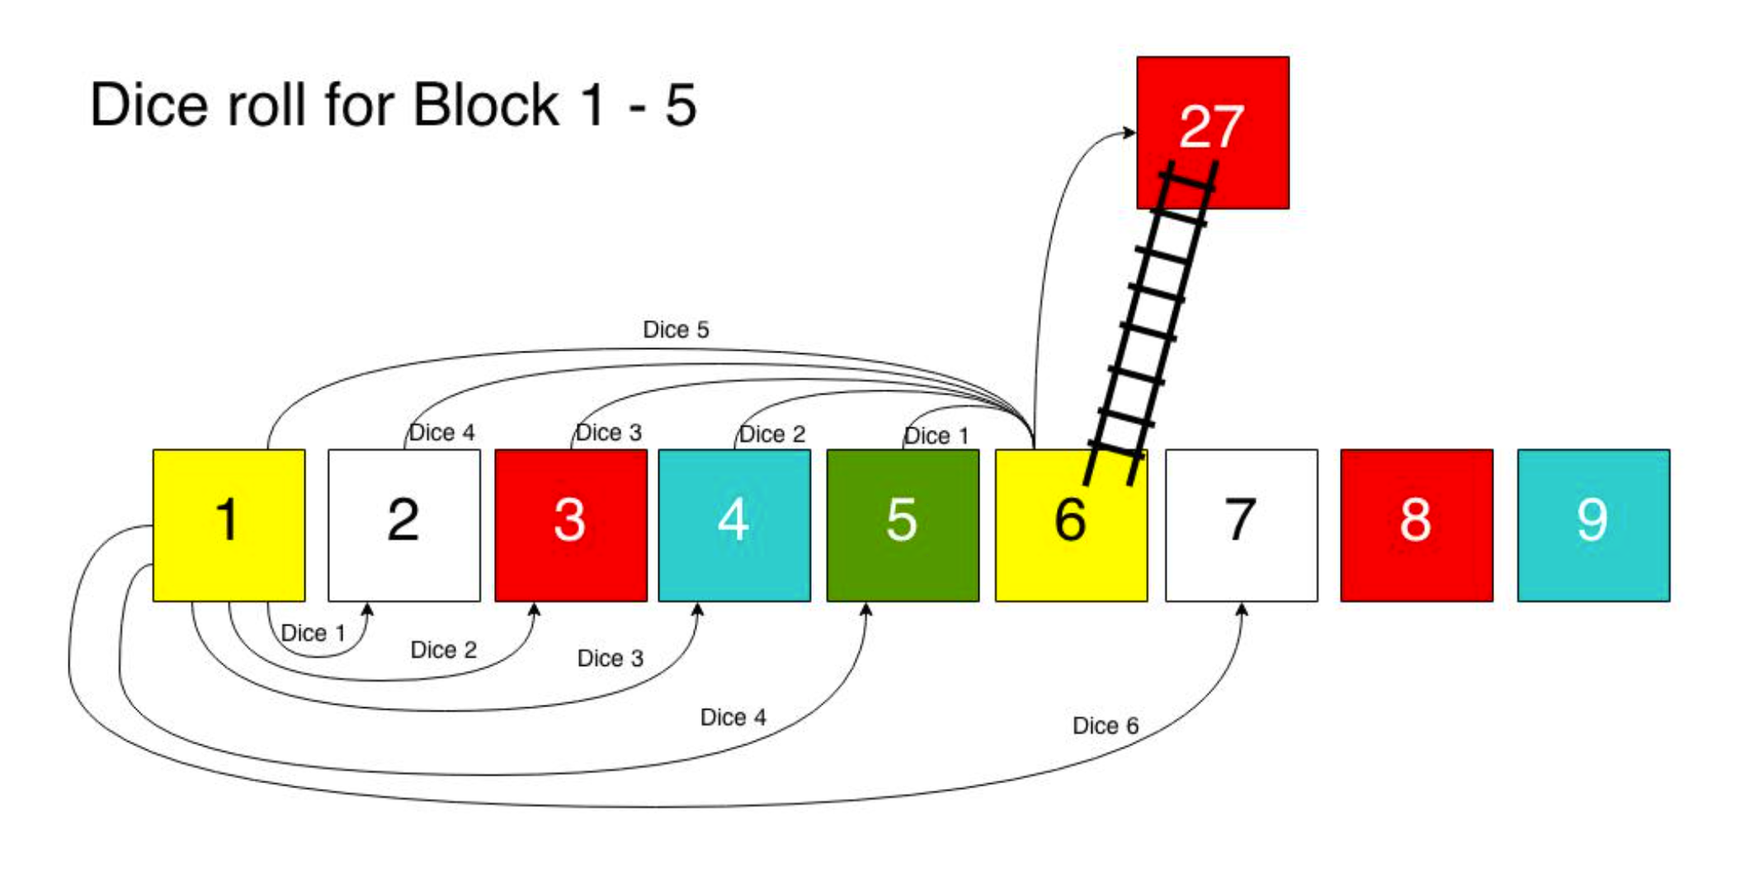
Dice roll for Block 1-5
If you roll 5 from block 1 you will jump directly to block 27. So is for block 2 when you roll out 4 or block 3 when you roll out 3 and so on. Now, “logically” speaking, the block 6 does not exists in our graph…!
Think about the statement for a while. Whenever you reach block, you are directly jumping to block 27, you don’t stay there.

Slide 26
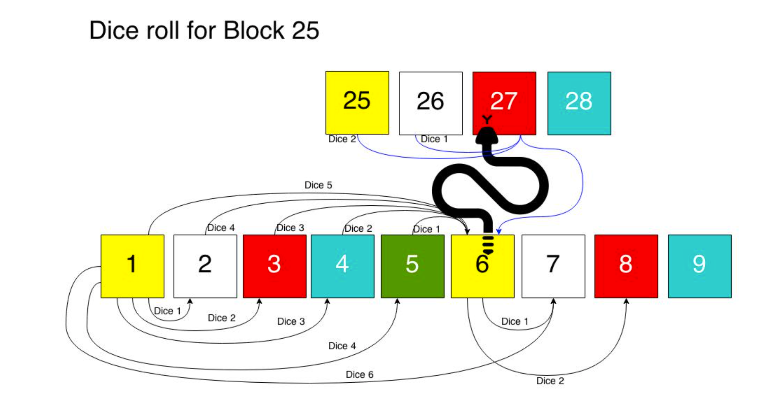
Dice Roll for 25
We assume that getting caught by a snake is always unfavorable and will not add to the progress of a short path. Just to get a better idea of the scenario of a ladder and snake, I have depicted what the Adjacency List would look like for the above two examples shown in the pictures.

Slide 27
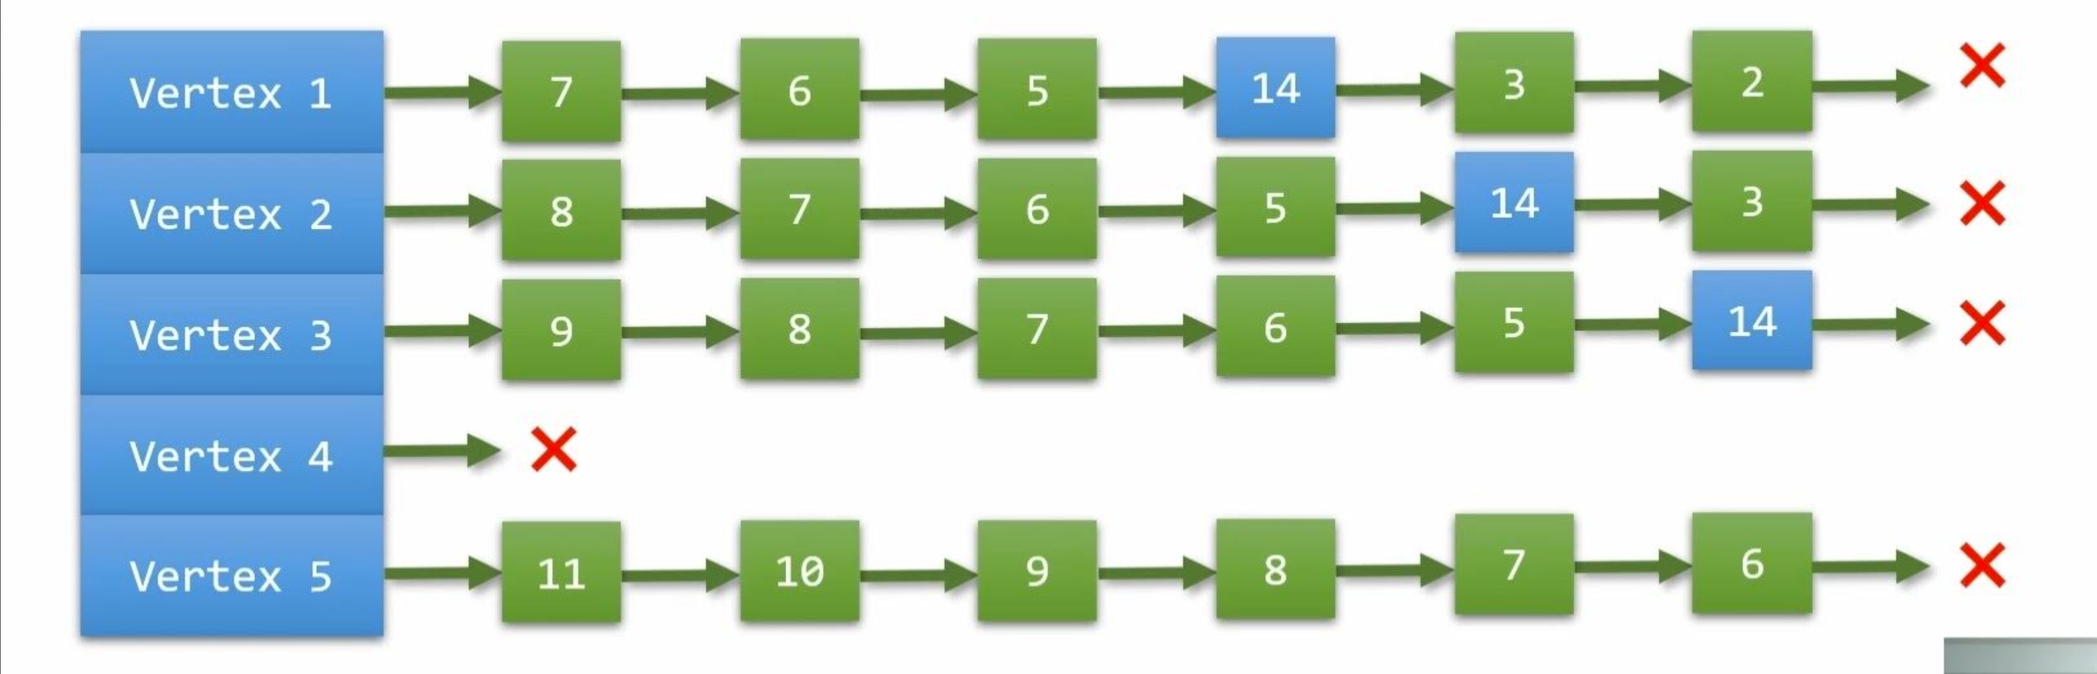
Linked List
Since there’s a ladder at vertex 4, as there’s a ladder which takes the player from 4 to 14
To generalize the vertices having the ladder on the Gameboard, the linked list will be empty

Slide 28
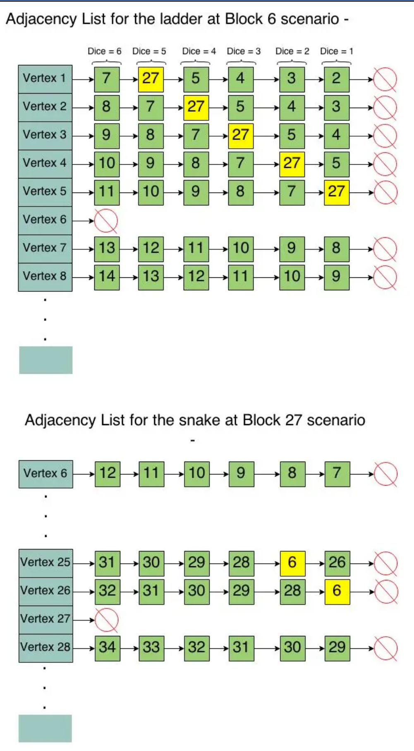
Adjacency List for the ladder at Block 6 scenario

Slide 29
Problem Statement
Here, we are trying to obtain the minimum number of dice rolls required to finish a game of Snakes and Ladders. The program takes inputs from the user to build a user defined board for the BFS algorithm to run on. The BFS algorithm is combined with the implementation of adjacency list for ease of execution of the algorithm.

Slide 30
Synopsis of our approach
We are using queues and adjacency lists for executing our snakes and ladders code. Queues are used for storing the next vertex that is supposed to be explored. Adjacency lists are used to store the neighbouring vertices that can be hopped onto after reached the current vertex. The hops are achieved at the dice roll. We are also storing the parent vertex of the current vertex.

Slide 31
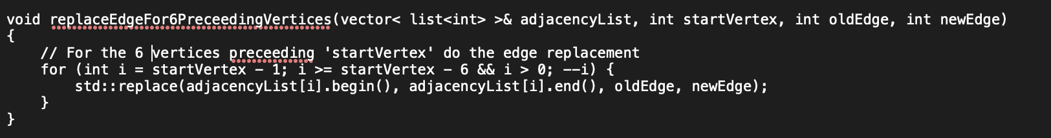
Our Implementation: replaceEdge function
This function is used to replace the 6 edges that contain the vertex which is ladder or snake. The adjacent elements of that vertex are erased and it is redirected to the top of the ladder or the bottom of the snake as the case may be.

Slide 32
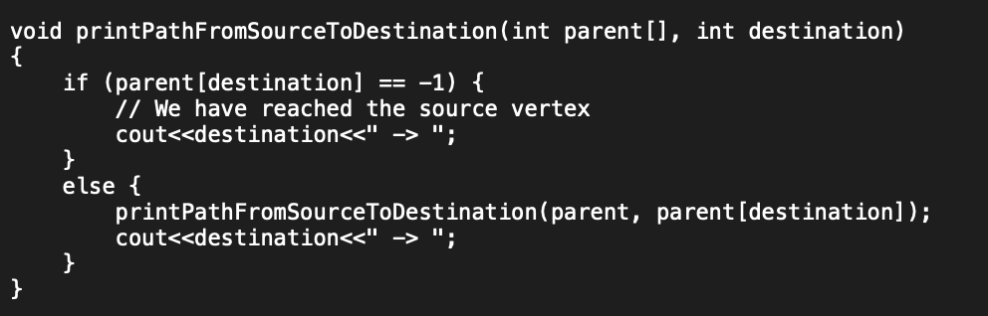
Our Implementation: printPath function
This function is used to print the path from source to destination i.e. From position 1 to 100 in a custom print style

Slide 33
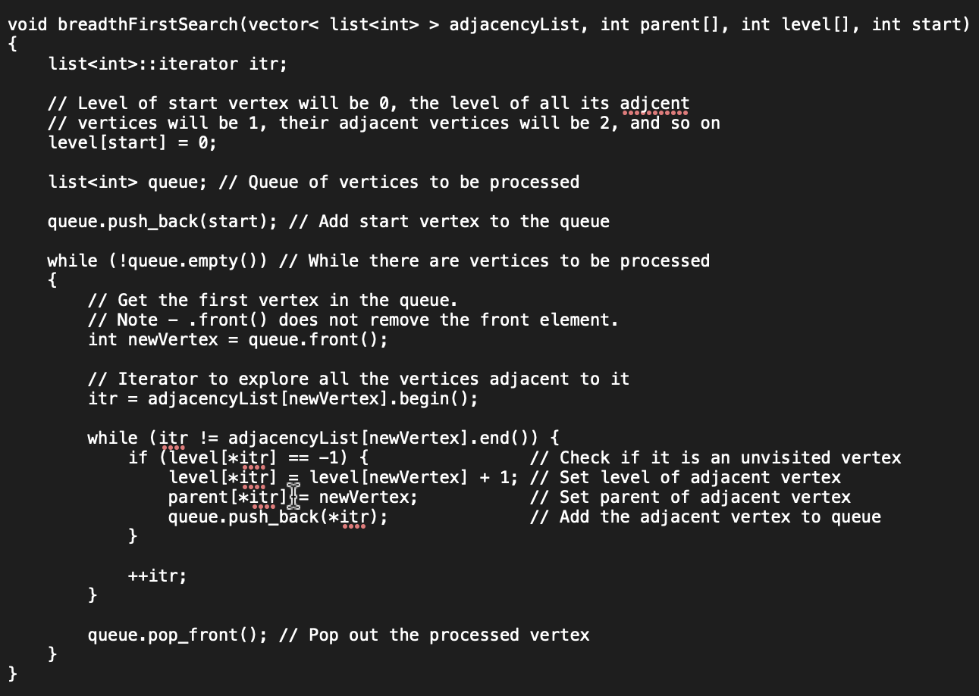
Our Implementation: BFS function
This is the main BFS algorithm where it searches for the minimum number of dice rolls required according to the given board to go from start till end.

Slide 34
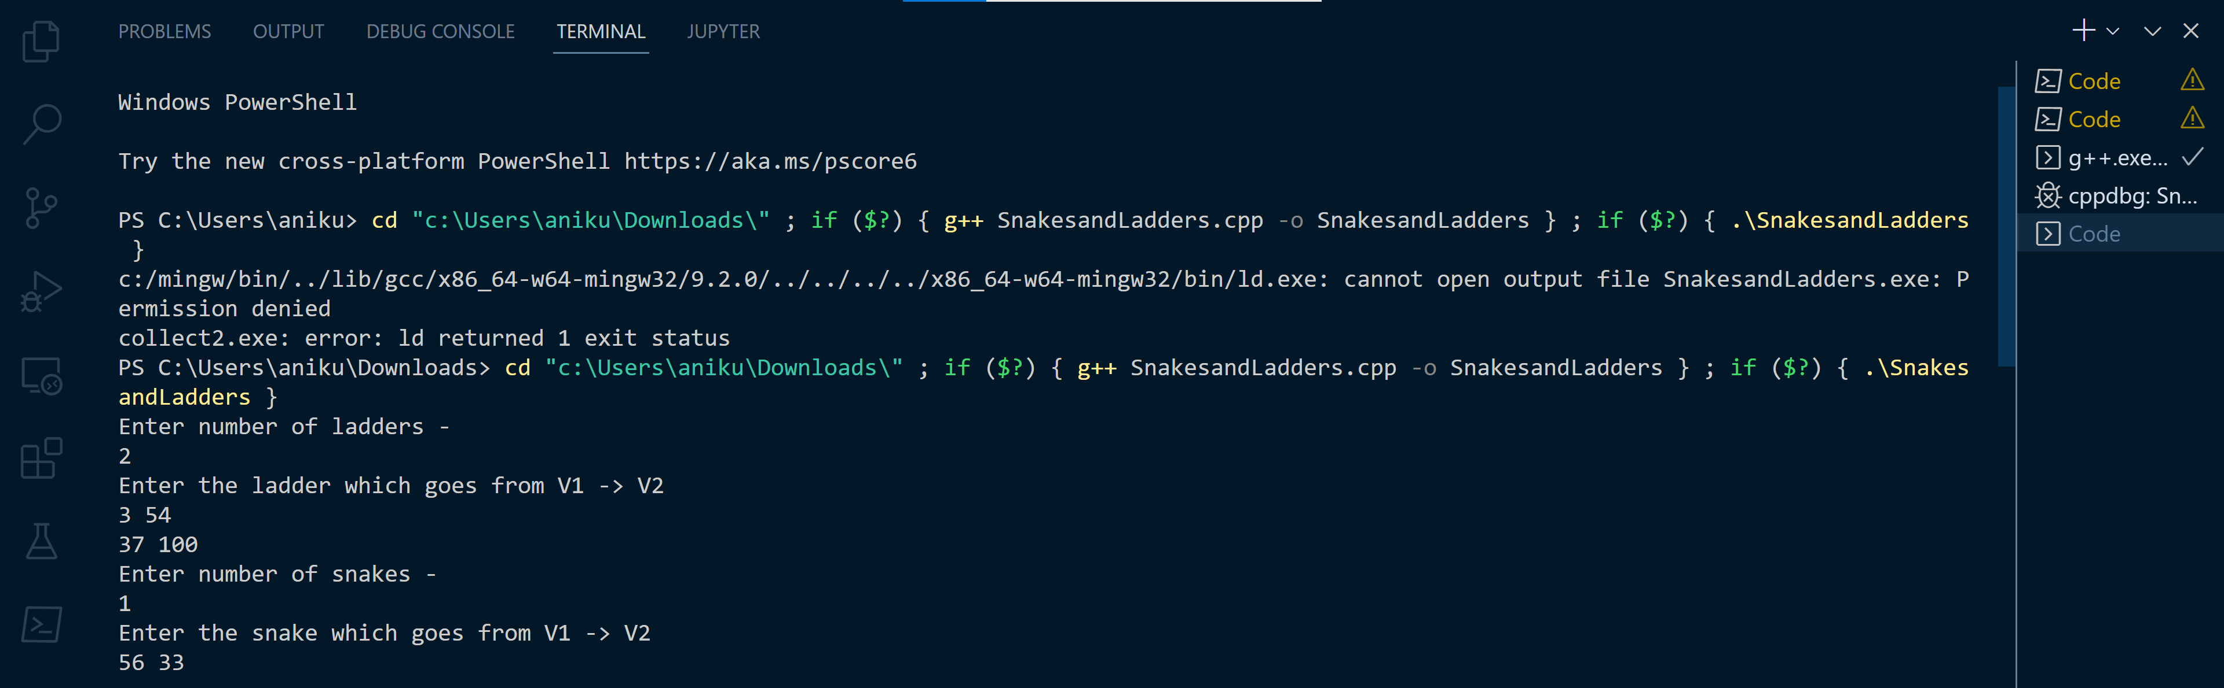
Execution: Inputs
We gave a custom board for execution

Slide 35
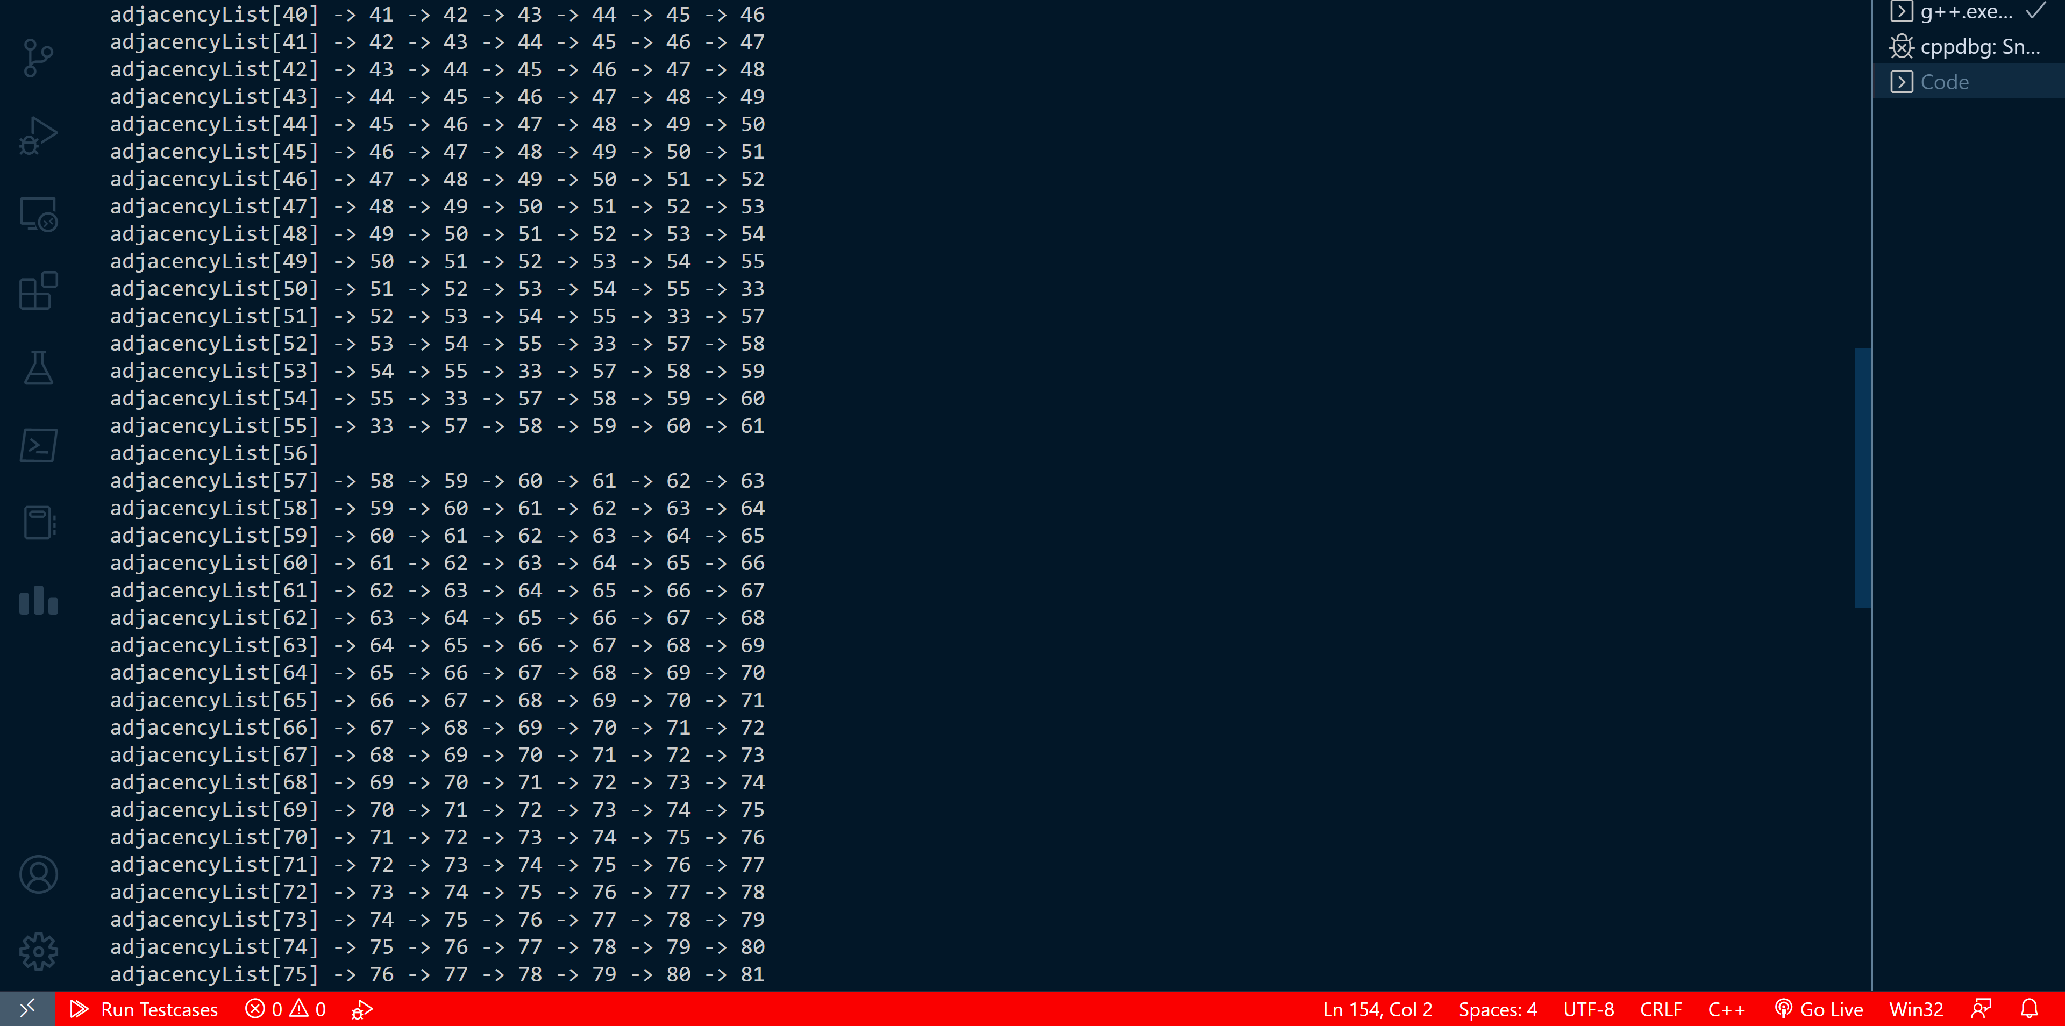
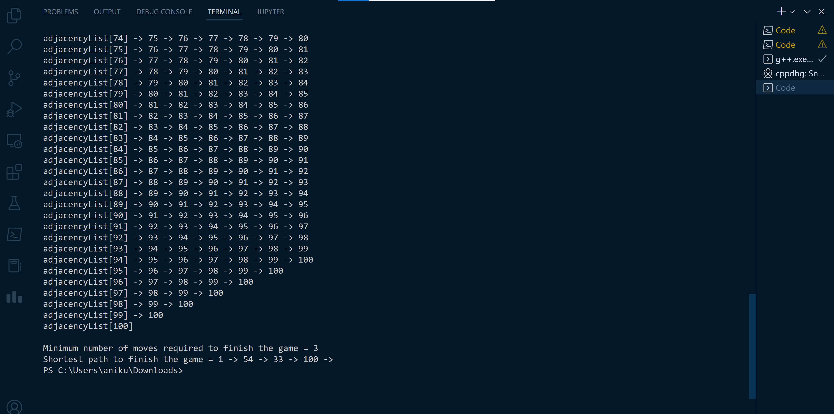
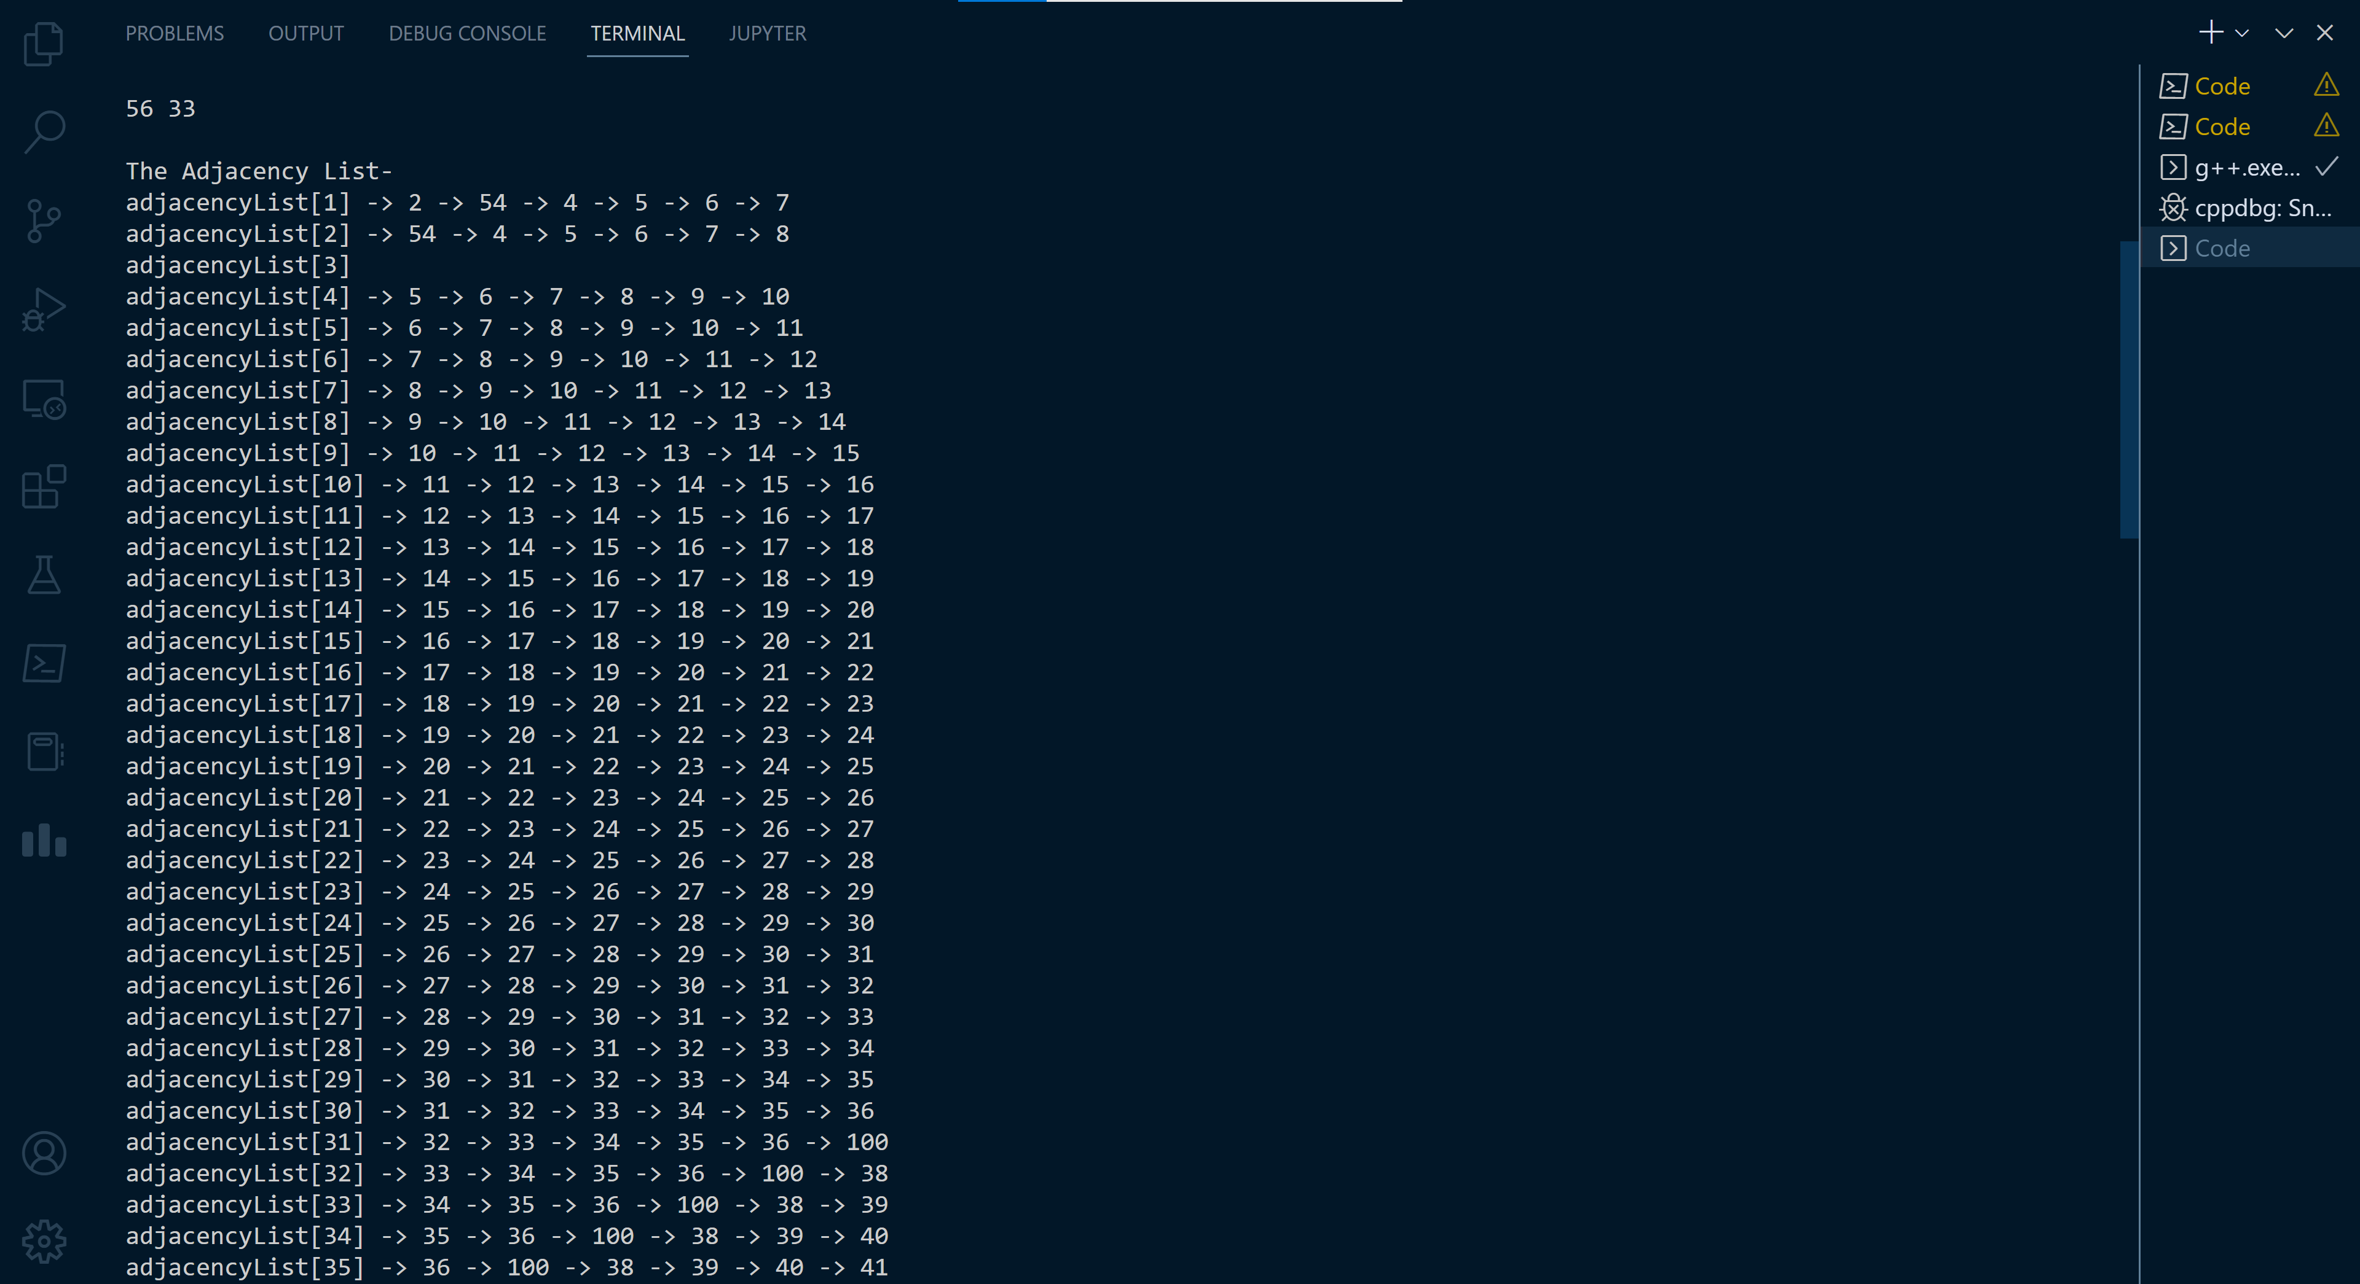
Execution: Output
Here is the output of the given snakes and ladders board

